Slide 1
Team Epsilon
Team Members:
∙ Thomas Zachry ∙ Diane Chin ∙ Randy Thien Cao ∙ Charlie Pan ∙ Shayan Raza

Slide 2
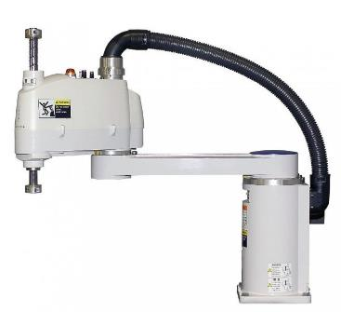
Project :
Scara Robot

Slide 3
Previous Sprint goals
System components research
Parts ordered
SCARA Process research
System Requirements document
SCARA Kinematics
Skeletal Assembly

Slide 4
PROGRESS
Parts received:
Motors
Minnowboard
Teensy boards
Learning Kinematics
Learning Computer Vision
System Requirements Document complete

Slide 5
ACCOMPLISHMENTS
System Requirements Document – Completed
Setting up Ubuntu on computers – Completed
Learning to Control Hardware and Motors – Significant Progress

Slide 6
Burndown Chart

